Slide 1
Critical Path Method
(CPM)
Introduction to the Schedule Review Process
Steve Rothamer
Program Controls Schedule Engineer
Barstow Office
Waukesha, WI
January 26, 2023
Notes:
Introductions
Periodic breaks
Interactive presentation, ask questions, provide examples

Slide 2

Agenda
  Objectives
  What is CPM Scheduling
    Project Introductions
  Advantages
  Lessons Learned
  Goals of CPM Usage
  Schedule Review Preparation
  Baseline Schedule Review
  Monthly Update Schedule Review
  Delays and Claims
  Questions / Answers
Notes:
Agenda – talk about exercises and brief quiz at the end.

Slide 3

Objectives
Learn the different components of a CPM schedule
Understand what elements make a good CPM schedule
Review baseline and update CPM schedules for accuracy
Identify risks in CPM schedule
Evaluate delays and understand impacts

Slide 4
What is CPM Scheduling
  A project management timetable, typically presented in graphic form.
  Breaks an overall project down into individual tasks. Those tasks are assigned a duration and sequence using relationships that dictate the order of operations.
  Calculates the minimum time needed to complete a construction project alongside the possible start and end times for the different activities.
  Allows for clear and transparent management of a project's critical activities to prevent delay.
Notes:
CPM schedule is a communication tool.
Provides contractor’s plan to construct the project to all parties.
Details of the various components will be addressed in later slides.

Slide 5
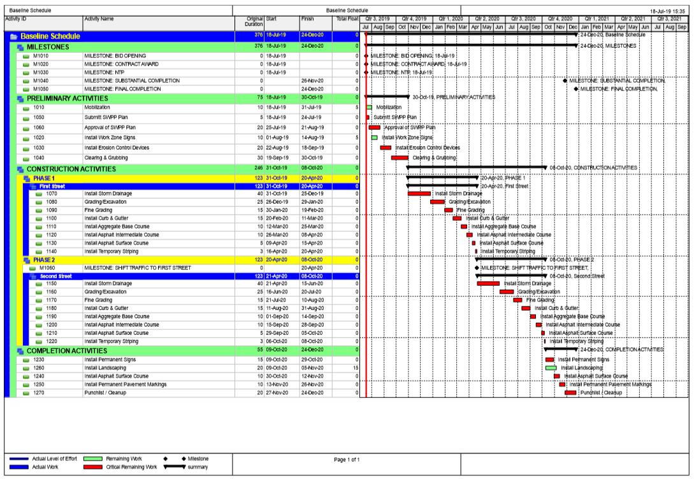
How to CPM Schedule
Model contractor’s plan to construct the project:
Define calendar when work will be performed
Develop Work Breakdown Structure (WBS) to organize tasks
Identify tasks in activities
Assign activities durations
Sequence activities using relationships
Report schedule using Gantt charts and other reports
Notes:
Calendars are important to model when the work will be performed.
WBS organization is not dynamic, larger projects will require activity codes to provide additional organization.
Include activities for all essential work.
Duration requirements will be discussed in later slides.
Reports communicate the plan.
Plan the work … Work the plan.

Slide 6
Importance of CPM Scheduling
Provides a standard method of documenting and communicating project plans
Provides all project personnel a complete overview of the total project
Identifies the most critical elements in the plan​
Helps to compare the planned with the actual status of project​
Provides established methods of reviewing and analyzing contractor claims for delay​
Notes:
Important to include all scopes of work to represent the entire project.
Must include work by others, utilities, or other entities to show potential impacts.
This will be discussed in further detail in later slides.

Slide 7

Software Platform
WisDOT utilizes Oracle Primavera P6 statewide
Contractors submit schedule via an XER file​ along with a narrative and printouts of the schedule
Notes:
Use of standardized scheduling software allows department to produce multiple reports.
Breakdown a large schedule into focused areas (structures, roadway, stages, etc.)
Narrative and printouts also required.
Printouts used to verify that the XER file matches the printout.
Example of when they don’t match, time lost analyzing the wrong information.

Slide 8
Project Introductions
  STH 50
  Zoo IC North Leg
  Waukesha By-pass
  IH 43 Capitol Dr. to Hampton Ave. (URT)
  94 N-S Mitchell Interchange
  Zoo IC Swan Blvd.
  Hoan Bridge and Lake Freeway
  Zoo IC Greenfield Avenue Bridge
Notes:
These projects are used to provide examples.
Not intended to show one is better than the other, or one contractor is better or worse a CPM scheduling.
Each new project will provide new scheduling challenges and opportunities.

Slide 9

Advantages /
Lessons Learned
Notes:
In this section we’ll talk about
Advantages
Lessons learned
CPM schedules are not only used in the construction process but also in the design progress
We’ll talk about a few advantages in the design process as well
When is a CPM schedule required?

Slide 10
Advantages of CPM
Encourages a logical discipline in the planning, scheduling, and control of projects
Encourages more long-range and detailed planning of projects
Provides a standard method of documenting and communicating project plans
Provides all project personnel a complete overview of the total project
Identifies the most critical elements in the plan
Helps to compare the planned with the actual status of project
Provides established methods of reviewing and analyzing contractor claims for delay
Notes:
Important that the schedule be utilized as a planning and management tool.
Sometimes seen as required paperwork or a box to be checked for monthly payment.
Advantages are reduced when schedule is not taken seriously.

Slide 11
Lessons Learned of CPM
Critical path of the CPM of a complex project is not always clear
Relationships and dependencies are not always clear
Becomes ineffective and difficult to manage if it is not well-defined and stable
Cannot effectively handle sudden changes in the implementation of the plan
Losses worth if project/plan changes and revisions are not documented
Notes:
There can be multiple critical paths and near critical paths.
Important to focus on the critical path but not lose site of near critical activities.
Various reports utilized to help clarify the schedule.
Value of CPM lost if work in the field does not match the schedule sequences.

Slide 12

CPM Schedule Benefits in Design
Planning, scheduling, and phasing
Determine staging relationships and interdependencies
Confirm planned durations
Calculate required production rates
Review constructability issues
Confirm project completion dates
Plan for and minimize risk
Notes:
Scheduling utilized in Design to organize and plan programs and projects.

Slide 13

When to Require a CPM Schedule
Contractor CPM Schedule for Projects > $10 M
Scheduling Workshops for Projects > $40 M
Weekly Production Data for Projects > $100 M
Rolling Three Week Look-Ahead for All Projects
Project complexity / multi-stage / multi-year
Notes:
The level and detail of CPM schedule is often defined by the size of the program and/or project.
Standard specifications provide details on other methods of scheduling.
A program PMP will often determine when CPM scheduling is required.

Slide 14

Goals of
CPM Usage
Notes:
In this section we’ll talk about
Why we require CPM schedules
Elements to review in schedules
What should be included in the schedule

Slide 15
Schedule Goals
Why does WisDOT require a baseline schedule?
Notes:
A CPM schedule on a large project can be a lot of work.
Require hundreds of hours to develop
Require several submittals to get approved
Why does the department require a baseline?
Solicit audience input. Try to get a few response.

Slide 16
Schedule Goals
Why does WisDOT require a baseline schedule?
To ensure the contractor has developed a proper plan
To ensure the contractor coordinates their work with the work of others
To ensure the contractor’s plan conforms to contract requirements
Evaluate the status of incentives and/or disincentives
Plan work force and equipment requirements for both the project and the region
Identify where to concentrate efforts to facilitate construction
Notes:
A baseline will tell us a lot of information.
Calendars details on hours/day, days/week
Durations provide production information when compared to scope of work
Sequence can reveal the number of crews and/or equipment a contractor’s plan includes
Helps the department plan for work force and equipment requirements.

Slide 17
Schedule Goals
Why does WisDOT require update schedules?
Notes:
To be useful, updates must be accurate
A lot of time is spent tracking and monitoring progress
Data must be correctly input into the software
Why require an update schedule?
An update schedule is just as important as a baseline.
Solicit audience feedback.

Slide 18
Schedule Goals
Why does WisDOT require update schedules?
Monitor progress of the project
Document completed project progress
Track progress payments that may be tied to the schedule
Identify the effects of others’ progress on the work
Make informed decisions during the project due to unanticipated events
Anticipate and reduce risk
Claim mitigation
Notes:
Is the project on schedule?
Is the contractor working the plan?
Is the contractor working the critical path?
Importance of coordination with others that may impact this project.
Ask for examples of unanticipated events (VIP/Presidential visit, sports post season playoffs)

Slide 19
Elements to Review of a CPM Schedule
  Confirm the schedule is reasonable and attainable
  Understand Contractor’s Means and Methods
  Establish a good baseline for monitoring
  Verify durations
  Verify logic and sequencing
  Identify claims positioning issues
  Identify risks in schedule and assumptions
  Document concerns
Notes:
What do we look for when reviewing a schedule?
Can anyone provide examples of other things to look for in a good schedule?
We’ll go through this in more details later in the presentation.

Slide 20
Schedule Goals
  What should be scheduled?
  Everything!
Notes:
Important to ensure that all essential scope of work are included in the schedule.
Work in broken down into manageable activities with adequate durations.

Slide 21

Schedule Review
Preparation
Notes:
This section of the presentation will discuss the various components of a CPM schedule
Also covered is where to find information on CPM schedule requirements
It is not intended to be an exhaustive study but a basic introduction.
Important to have an understanding to the components of a CPM schedule on how they are constructed.
This helps understand how and why activities scheduled.

Slide 22
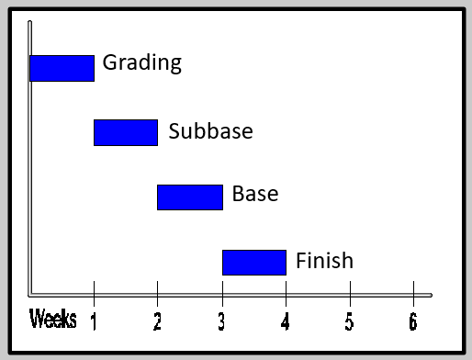
CPM Schedule Terms
Activity
Critical Path
Total Float / Free Float
Work Breakdown Structure (WBS)
Initial Work Plan
Baseline
Monthly Update
Notes:
Basic CPM terms – ask audience of definitions.
Activity is unit of work. Best to limit activity scope to one trade and/or subcontractor.
Critical path – Sequence of dependent activities that determine the minimum time needed to complete the project.
Total Float – note how constraints can affect float calculations.
WBS – hierarchical organization of all tasks (static), used organize activities and make a schedule readable
IWP first 90 days, baseline is the contractor’s plan, updates monitor the progress

Slide 23
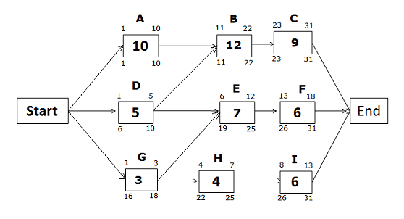
CPM Schedule Terms
Basic Activity Properties
  Activity/Task ID
  Activity Name (Description)
  Original Duration / Remaining Duration
  Activity Codes
  Calendars
Notes:
Activity ID is a unique identifier assigned to each activity
Activity Name describes what scope of work is included in the activity (who, what, where)
OD is the estimate number of days an activity with take from start to finish
RD the number of days an activity with take to complete after starting
Activity codes are used to provide flexibility in the schedule to allow for grouping, sorting, and filtering activities
Calendar used to define when the work will be completed (hours/day, days/week)

Slide 24
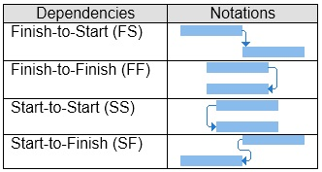
CPM Schedule Terms
Logic Relationships (predecessors/successors)
  Four types of relationships:
  Finish-to-Start (FS)
  Start-to-Start (SS)
  Finish-to-Finish (FF)
  Start-to-Finish (SF)
  Relationship Lag
Notes:
A CPM schedule contains four type of relationships
FS is the most typical relationship (A must finish before B can start)
SS and FF can be used to show activities that overlap
A must start before B can start
A must finish before B can finish
SF is unusual and rarely used (A must start before B can finish)
Lag is used often with SS and FF to show overlap
Never use FS lag or negative lag

Slide 25
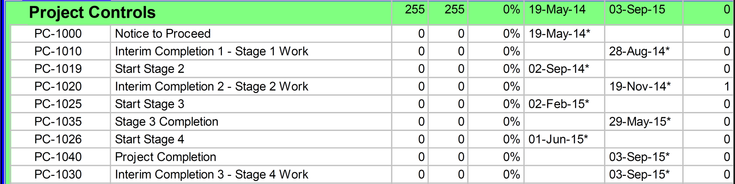
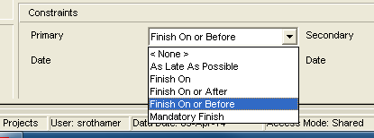
CPM Schedule Terms
Basic Network – Calculated Properties
  Early Dates
  Late Dates
  Total Float
  Free Float
  Constraints
  Negative Float
Notes:
A schedule gets calculated after a schedule is setup, activities created, relationships assigned.
Early dates are the earliest an activity can start, and finish based on the durations and logic.
Late dates are the latest an activity can start and finish without delaying the project.
A comparison of the early dates and late dates provides the total float.
Total float is the duration an activity can be postponed without delaying the project.
Free float is the duration an activity can be postponed with delaying any other activity.
Constraints are preset dates when activities can start and/or finish. Constraints override the logic of a schedule.
Negative float is the number of workdays an activity is beyond a target completion date.

Slide 26
Plans and Specifications
Standard Specifications
  Specification Section 108.4 Progress Schedules
    108.4.1 General
    108.4.2 Bar Chart Progress Schedule
    108.4.3 Relationship Bar Chart Progress Schedule
    108.4.4 Critical Path Method Progress Schedule
Notes:
The Standard Specifications provides detailed requirements on what should be included in a CPM Schedule.
108.4 is the place to look for these requirements
108.4.4 provides the details for CPM schedules
Open link and show different headings. Details to be covered in future slides.

Slide 27
Plans and Specifications
Special Provisions
  STH 50 Article 127 Replaces Spec. Section 108.4
  Zoo IC North Leg Article 172 Replaces Spec. Section 108.4
  Intermediate and Final Completion Dates
  Staging
  Holiday Work Restrictions
Notes:
Larger project will provide additional CPM requirements in the Special Provisions.
The Special Provisions may replace the CPM requires of the Standard Specifications
Other important schedule information can be found in the Special Provisions such as:
Interim and Final completion dates
Staging requirements
Holiday Work Restrictions
Ask audience for other examples of schedule information in the Special Provisions

Slide 28
Plans and Specifications
STH 50 Special Provisions Article 127
108.4.4.1 – Initial Work Plan
108.4.4.2 – Baseline CPM Progress Schedule
108.4.4.3 – Monthly CPM Updates
108.4.4.4 – Three-Week Look Ahead Schedules
108.4.4.5 – Weekly Production Data
108.4.5 – Progress Review Meetings
108.4.6 – CPM Progress Schedule Revisions
108.4.7 – Documentation Required for Time Extension Requests
108.4.8 – Payment for CPM Progress Schedule
Notes:
Example of a Special Provision that replaces the Standard Specifications
Open link and show example and article headings

Slide 29
CPM Schedule Process Steps
Initial Work Plan
  Due at least 14 calendar days before the preconstruction meeting
  Detailed bar chart for the first 60 calendar days of work
  Within 5 business days after the meeting, the engineer will accept or request additional information
  Maintain and submit bi-weekly updated version
  Used to monitor the progress until accepting the baseline schedule
​
Notes:
Sequence of IWP submittal with requirements shown based on Standard Specifications
Special Provisions may include other requirements
Often requires details in the first 90 calendar days
Provide summary activities for the balance of the project
Ensure IWP shows completion the work within the interim and final completion dates

Slide 30
CPM Schedule Process Steps
Baseline Schedule
  Due within 30 calendar days after notice to proceed
  Engineer will schedule a review meeting with the contractor within 10 business days after initial submittal
  Review comments due back to contractor within 5 business days after the meeting
  Contractor has 10 business days to revise and resubmit as-needed
  Department will only make progress payments for the value of materials until the baseline schedule is submitted
  Department will retain 10% of each estimate until baseline is accepted
Notes:
Sequence of baseline submittal requirements shown based on Standard Specifications
Special Provisions may include additional requirements
Often includes activity and duration requirements

Slide 31
CPM Schedule Process Steps
Update Schedules
  Update the schedule monthly
  Hold a job-site schedule review meeting with the contractor within 5 business days after submittal
  Review accuracy of schedule at the meeting
  Contractor has 10 business days to revise and resubmit as-needed ​
​
Notes:
Sequence of update submittal requirements of Standard Specifications shown:
Special Provisions may include additional requirements
Note the timing of these steps is important. Project teams should endeavor to meet these requirements as defined in the contract documents.

Slide 32
CPM Schedule Process Steps
Schedule Revisions
  Engineer can request revisions if:
    Interim or final completion dates are 14 calendar days late
    Progress in the field differs significantly from the schedule
    Change order requires the addition, deletion, or revision
  Submit revised schedule within 10 business days after request
  Hold job-site meeting within 5 business days to review revisions
  Adjust schedule and resubmit as-needed to address concerns ​
​
Notes:
Unexpected events or issues may arise on a project. The department can request revisions to the contractor’s schedule.
Provisions shown are from the Standard Specifications, Special Provisions may be different.

Slide 33

Weather
Anticipated weather impacts to progress and completion dates
Often incorporated into schedule calendars
May be excluded as a reason to grant time extension
Track weather impact days to allocate time as needed
Notes:
Finally, it’s important to consider weather when developing a CPM schedule.
Standard Specifications an anticipated number of weather days each month (open link).
Engineer will entertain requests for time extension due to weather only when actual number of adverse days exceed the anticipated number.
Adverse weather is often modeled in the schedule calendar (open link).

Slide 34

Baseline Schedule
Review
Notes:
This section will discuss
What to review in a baseline schedule
Addresses the use of float in a schedule
Properties of good schedule vs. schedule shortcomings
Baseline examples and a short exercise
Open File Explorer to show list of reports and discuss what is provided for the reviewer to review.

Slide 35
Reviewing Baseline Schedule
What do reviewers review in a Baseline schedule?
  Schedule submittal is complete and meets the requirements of the Special Provisions
  Schedule based on template and WBS
  Organization – Is the schedule hard to read?
  Activities for all work including procurement
  Coordination with Utilities and third parties
  Appropriate logic relationships
  Durations and planned production rates (quantity / duration) are appropriate
Notes:
Reviews look at a wide variety of information in a baseline schedule.
A template is provided that give a general setup in the software
Encourages proper use of WBS, calendars, and activity codes
WBS should organize the project in a logical format that is easy to follow
Review procurement, utility, and third-party examples
Appropriate logic can be inferred from the activity dates
Production rates can be interpreted from the durations

Slide 36

Reviewing Baseline Schedule
  Ensure unnecessary or inappropriate constraints have not been used
  Schedule meets Contract milestone, phasing, weather restriction, lane closure, etc.
  Adequate time for Department work including submittal reviews, functional testing, procurement
  Level of detail is appropriate for size and scope of work
  Equipment and work force requirements
Notes:
Constraints can and do override schedule logic
Constraint dates can be identified by the asterisks by the start or finish date
As late as possible constraints (zero free float) is a way to suppress schedule float
Level of detail does not exclude any scopes of work
Equipment and work force requirements can be inferred from activities scheduled to occur simultaneously

Slide 37
Reviewing Baseline Schedule
  Interferences that may not be obvious – staging, overlapping, safety concerns, etc.
  Critical path makes sense
  Near-critical path makes sense
  Planned workflow makes sense
  Calendars are reasonable and holidays / restrictions have been included
  Schedule does not include inflated durations, constraints, or lags to lengthen the schedule
Notes:
Sequences that may not be allowed such as adjacent ramps may not be closed at the same time.
Calendars are usually printed in the baseline review so reviews can see details.
What other work restrictions may be present besides holidays? (sports, special events, state fair, Summerfest)
Inflated durations, constraints, lags that lengthen a schedule may be float surpression

Slide 38
Who owns the float?
Notes:
Solicit audience participation

Slide 39
Who owns the float?
Standard Specification 108.4.4.3 (3)
“Float is defined as the time between the date when an activity can start, the early start, and the date when an activity must start, the late start. The department and the contractor agree that float is a shared commodity, and is not for the exclusive use or financial benefit of either party. Either party has
the full use of the float until it is depleted.”
Notes:
Either party has the full use of the float until it is depleted.
So why can’t the contractor suppress the float in the baseline plan?
Provides an inaccurate plan for the project
Does not allow flexibility in the schedule
No float to absorb impacts, all impacts delay the project

Slide 40

Properties of a Good Schedule
Activities describing all construction work
Durations reflect a realistic estimate
Work sequence is achievable
Includes all required milestones
Reflects the current plan
Addresses procurement
Notes:
Reviewers will use their experience and knowledge to gauge what is reasonable.
What are some examples of what may not be reasonable or achievable?
Too many concurrent activities
Durations are too short or too long for scope of work
Activities that are too general (build bridge)
10 day submittal review durations

Slide 41
Properties of a Good Schedule
Good narrative
Identifies night work and shift work
Coordinates with third parties
Realistic logical relationships
Logic based on resource considerations
Efficient and correct use of CPM tools
Notes:
Standard Specifications or Special Provisions will provide details on what is to be included in a good schedule narrative.

Slide 42

Common Schedule Shortcomings
Poorly defined logic
Inadequate time for review, procurement, testing
Too many constraints
Improper use of leads and lags
Differs from required phasing
Too much or too little detail
Forced or non-existent critical paths
Notes:
Schedule shortcomings are often the opposite of what makes a good baseline schedule.

Slide 43
Design vs. Contractor Staging
Staging changes in the baseline schedule have the potential to impact completion dates
Design planned Stage 2B to be constructed in fall 2018
Contractor baseline schedule planned Stage 2B in spring 2019
No interim milestone or requirement for the contractor to construct Stage 2B in the fall of 2018
Stage 2B and succeeding work impacted by weather and other issues
Notes:
Example of design vs. contractor staging
Contractor scheduled Stage 2B in the spring of 2019 to get settlement for deep sections of fill prior to paving
Fill was not sealed to shed water
Fill was built and passed inspections
Precipitation prior to base caused contamination and had to be reconstructed
Several weeks of discussion between department and contractor
Impacted subsequent stages 2C, 2D, and 2E in order to get into Stage 3

Slide 44
Baseline Acceptance / Approval
Can a Contractor submit a schedule that shows an early finish?
Can the reviewer reject a schedule because it shows an early finish?
Can the reviewer accept a schedule because it shows a late finish?
Does accepting a schedule modify the terms and conditions of the
contract documents?
Can the department request a CPM schedule if the requirements for one is not included in the contract documents?
Notes:
Interactive Slide – solicit audience discussion.

Slide 45
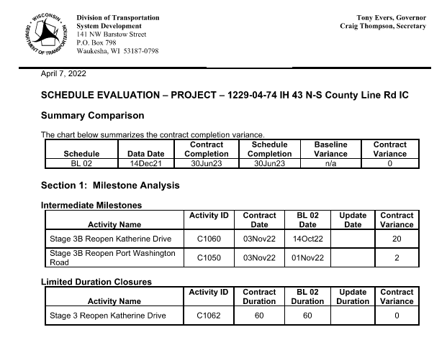
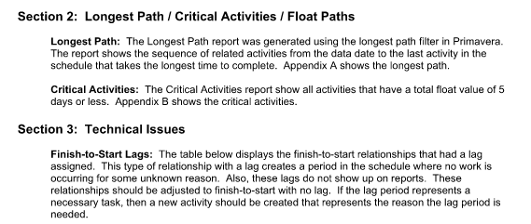
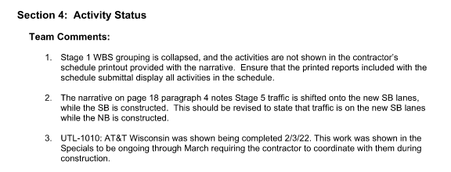
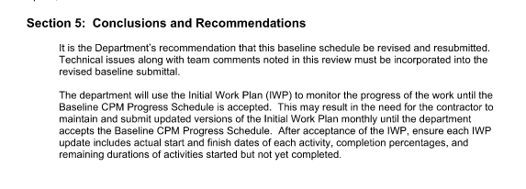
Baseline Review Example
Notes:
Click the first page link to open example review.
- Briefly scroll through and discuss different sections.

Slide 46
Baseline Review Exercise
Reconstruct an Interchange
Multi-year, multi-stage reconstruction of roadway, ramps, and bridges
Interim and final completion dates
  Stage 2A – Open Ramps: 07/14/23
  Stage 2B – Open to Stage 3: 11/15/23
  Stage 4A – Open Ramps: 06/07/24
  Stage 4B – Project Completion: 11/15/24
Utility conflict scheduled to be relocated by 05/01/23
Notes:
Introduce exercise
- Ask audience to gather in groups and develop schedule review comments

Slide 47
Baseline Review Issues / Comments
Negative float in 2024
Lacks utility activities (work by others)
Short durations on shop drawing approval and fabrication activities
Long durations for ramp activities, lack of detail
Traffic switch on July 4th holiday
Two-week gap between the end of Stage 2A and the beginning of Stage 2B
Girder erection scheduled prior to the completion of the pier
Bridge deck cure only 7 days in duration
Bridge structure not on the critical path to Stage 2B completion
Stage 2B completion is scheduled 12 calendar days prior to the interim date
Longest Path report driven by date constraint, doesn’t include 2023 activities
Notes:
Review list of comments with audience.

Slide 48

Monthly Update
Schedule Review
Notes:
This section will discuss
What to review in an update schedule
Addresses the different components of an update to consider
Compare the current update to the baseline and previous update
Run what-if scenarios to analyze potential revisions
Update examples and a short exercise
Open File Explorer to show list of reports and discuss what is provided for the reviewer to review.

Slide 49

Reviewing Monthly Update
Same standards apply to an update that applied to the baseline
Notes:
We reviewed the baseline standards, update standards are similar
Submittal date is not defined in the contract documents
Establish a routine submittal schedule that works for the department and contractor

Slide 50
Reviewing Monthly Update
What is the data date? Are all activities progressed up to the data date?
Have activities been assigned appropriate and accurate actual start and actual finish dates?
Review added, deleted, and changed work conditions
Check for modified durations (increase / decrease)
Revised logic relationships indicate a change in the plan
Review float variances – large changes could indicate revisions to the logic
Review items that took longer than planned or did not occur
Notes:
Data date is the point in time to which the schedule is updated.
Progress beyond the data date will be provided in the next update
Data date displayed in reports by blue vertical line and can be found in bottom left corner.
Details of added/deleted/changed work provided in a report.
- Use this information to identify trends or areas for schedule improvement

Slide 51
Reviewing Monthly Update
Review progress reported in the schedule – does this match actual progress in the field?
Compare current schedule to baseline and past updates
Identify critical path of interim and final completion dates – has it changed from the previous update?
Review production and compare to planned rates
Identify out-of-sequence progress – does the schedule accurately reflect the work in the field?
Compare CPM update to 3-week look ahead schedules
Notes:
Check comparison reports for areas that may have slipped.
Out-of-sequence progress indicates that the work in the field is not following to sequence modeling in the schedule.

Slide 52

Reviewing Monthly Update
Read the narrative report
Does the narrative meet the specification?
Is the information in the narrative accurate? Complete?
Does the narrative list all relevant events and impacts? Is anything missing?
Is the narrative consistent with the schedule update?
Notes:
Review narrative for statements that may lead to claims or delay that are not included in the schedule.
Consider including schedule review comments that address statements of delay or claim made in the narrative.

Slide 53
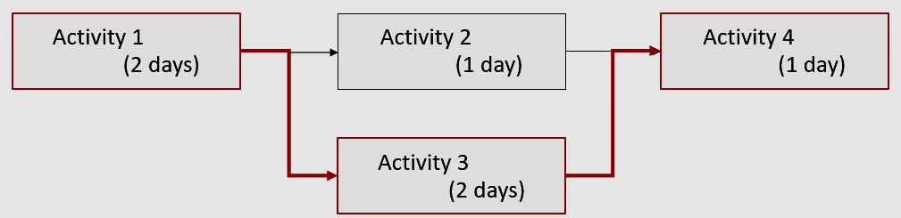
Reviewing Monthly Update
Major Problems
Unreasonable or unexplained logic changes
Many inaccurate dates or percent completes
Inaccurate representation of change order work
Notes:
Schedule update often include changes and revisions. Review these changes to look for issues.
Major problems with the schedule update may require the schedule to be revised and resubmitted.

Slide 54

Reviewing Monthly Update
  Minor Problems
    Inaccurate as-built dates
    Disagreements over activities with large amount of float
    Minor logic adjustments not described in the narrative
    Difference of opinion on progress if it does not affect critical path
Notes:
Minor problems can be addressed in the next schedule update.

Slide 55
What-if Scenarios
Department makes what-if revisions to analyze different scenarios
Revisions to calendars to change workdays, number of work hours per day, or work restrictions
Changes to activity sequences
Modify durations or relationship lags
Correct future actual dates or add missing actual dates
Analyze delay impacts and perform time impact studies
Notes:
What-if scenarios allow the department to see the impacts of revisions made to the schedule.
Use also for delay fragnet review when contractor doesn’t provide as needed
Examples of what-if schedules
Delay impact because contractor didn’t provide fragnet
See potential schedule recovery from revised staging
Correct mistakes in schedule update to find accurate critical path

Slide 56
Project Issues
C-67-91 Box Culvert
  East stage of the box required local traffic to be off old Merrill Hills Rd.
  SB pavement actual finish 10/03
  Contractor delayed switching traffic onto new pavement so that they would not have to work next to local traffic.
  This delayed C-67-91 East removal of old structure until actual finish 10/25.
  Had they moved local traffic onto the completed pavement the week of 10/07 they could have gained over 2 weeks on the schedule which could have allowed them to complete concrete paving over the box culvert and saved the expense of temporary asphalt for traffic through the winter.
Notes:
Example of project issue in monthly schedule update
Delays elsewhere on the project delayed traffic switch
New pavement was available, but contractor delayed switch for safety reasons
Contractor later worked to recover time on the east half of the box culvert

Slide 57
Project Issues
R-67-129 Retaining Wall
  Length of the tieback tendons extended beyond the right-of-way acquired for the wall system.
  Department explored options including purchasing additional R/W, pre-drilled piling with whalers and lightweight backfill.
  Lightweight backfill was the most cost effective.
  Late changes to the design resulted in additional costs submitted in the proposal.
  Change order was approved on 11/15/19.
  Installation of the post/panel wall required horizontal benches.
  Due to work zone required by the installer, excavation of the roadway adjacent to the wall system had to wait
  The completion of the excavation and placement of fill had to wait for the frost to come out.
Notes:
Shop drawings show tieback tendons extending beyond the right-of-way
Contractor was told to redesign
Contractor demonstrated that there was no way to design using the available right-of-way
Resulted in impact to project completion date and winter work
Changed to lightweight fill in replace of the tiebacks

Slide 58
Update Acceptance / Revisions
Schedule accurately reflects progress, but it misses the milestone dates?
Schedule update has been forced to fit but does not accurately represent progress in the field?
Schedule sequence of work (N-S) is opposite of work in the field (S-N)?
Does accepting a schedule modify the terms and conditions of the contract documents?
Notes:
Interactive Slide – solicit audience discussion.

Slide 59
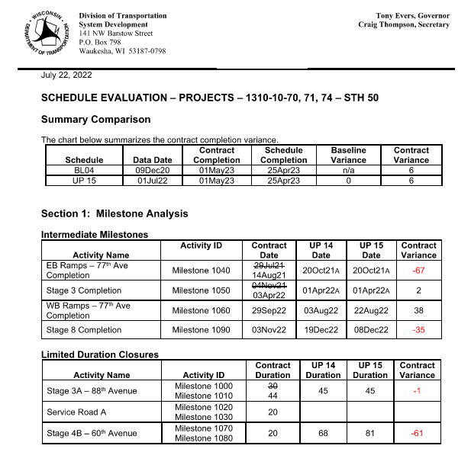
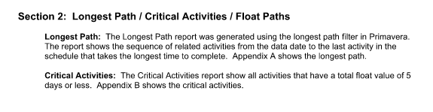
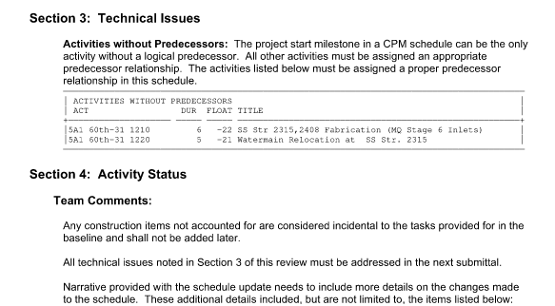
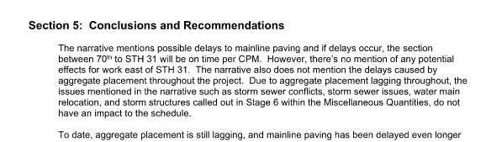
Update Review Example
Notes:
Click the first page link to open example review.
- Briefly scroll through and discuss different sections.

Slide 60
Update Review Exercise
Multi-year, multi-stage reconstruction of roadway, ramps, and bridges
Interim and final completion dates
  Stage 2A – Open Ramps: 07/14/23
  Stage 2B – Open to Stage 3: 11/15/23
  Stage 4A – Open Ramps: 06/07/24
  Stage 4B – Project Completion: 11/15/24
Schedule update submitted on Friday, September 1st, at 4:56 p.m.
Schedule data date is August 1st
Notes:
Introduce exercise
- Ask audience to gather in groups and develop schedule review comments

Slide 61
Update Review Issues / Comments
Update submitted one month after the data date
Additional activities added for construction of the ramps
Stage 2A completion date is two weeks after the contract completion date
Stage 2B scheduled completion is after the contract completion date
AD for Common Excavation, Select Crush, and Base Course significantly longer than the OD in Stage 2A roadwork STA 240 to STA 255 segment
Stage 2A Comment Excavation STA 272 to STA 302 segment finishes after Storm Sewer, Select Crush, and Base Course activities
MSE Wall Panel started but the RD is longer than the OD
South Abutment activity has out-of-sequence progress
  MSE Wall Panel activity delaying the completion of the south Abutment activity
Bridge pier Stems and Cap activities have actual dates after the data date
Notes:
Review list of comments with audience.

Slide 62

Delays and Claims
Notes:
The section will discuss delays and claims
Will include non-critical and critical discussion.
Go over what required to submit a delay claim and what to review in the claim.
Finish with an example and a brief exercise.

Slide 63
Delays and Claims
Delays can affect critical or non-critical activities
Delays can affect intermediate milestones, but not the project completion milestone, or vice-versa
Notes:
Delays can affect critical and/or non-critical activities.
Delays may affect interim dates but not final dates.

Slide 64

Delays and Claims
Delays to non-critical activities use float
Delays that just use float and do not affect a milestone or completion date are not due a time extension
Notes:
Delays to non-critical activities use float and are not due a time extension.

Slide 65
Delays and Claims
Time extension requests associated with Changes to work
  Narrative discussing the changes and its affected activities
  Proposed fragnet to be added in the schedule
  Time extension requests associated with Delays to work
    Narrative discussing the change and its affected activities
    Review time extension at time of delay
    Other issues or lack of progress can cloud the original issue if reviewed months later
Notes:
Fragnet means “fragmentary network”. A small number of activities to be inserted into a CPM that represents the change condition or delay. A fragnet is used to evaluate the impacts of the change.
Best to review a delay or potential delay is when it occurs.

Slide 66

Delays and Claims
Review change-based time extension request
Check dates are consistent with project records
Check fragnet relationships are reasonable
Check that durations are what is known at the time
Ensure that the appropriate update was used
Check for constraints on activities that could cause work to incorrectly appear critical
Notes:
Fragnet is to be inserted into the latest approved schedule update.
An approved update that is several months removed from the change will be problematic
Ensure other revisions to the schedule not related to the change are not affecting the fragnet

Slide 67
Delays and Claims
Reviewing delay-based time extension
Best practice to review delays when they happen rather than waiting
Based on the project updates and the explanation in the narrative
Examine the appropriate update to determine if the delay is on the critical path
Review narrative explanation and compare to project records
Check for alternate explanation of the delay
Make sure responsibility for the delay has been established
Check for concurrently critical contractor delays

Slide 68
Delays and Claims
Reviewing change-based time extension
Example Zoo IC Flash Butt Welding
  Change rail welding method
  Baseline schedule included 10 days for subballast/ballast work and 15 days for track installation
  Contractor fragnet added activities for excavation, sub-ballast, ballast, and welding
  Increased subballast/ballast duration by 29 working days
  Department used field observations rather than contractor fragnet to determine total delay on temporary bridge
  Utilized field observations and previous schedule update to assign delay on permanent bridge
Notes:
Department also used a what-if schedule to insert a fragnet for delay analysis.

Slide 69
Claim Review Exercise
Claim Scenario 1
  June update submitted with a time extension claim
  Utility relocation that was supposed to be complete by 05/01/23 is not scheduled to be complete until 06/07/23
  Contractor lack of progress and inefficiencies
  Stage 2A interim date scheduled to be later than the 07/14/23 contract date
Claim Scenario 2
  Department requests that contractor incorporate bedrock activities into revised update
  September revised update includes bedrock activities
  Interim completion date is later that the 11/22/22 contract date
Notes:
First scenario shows potential concurrent delay.
Second scenario shows delay activities have positive float.

Slide 70

Questions /
Answers
Contact Info:
Steve Rothamer
mobile: (773) 307-9473
email: steve.rothamer@dot.wi.gov

Slide 71
Quiz
Notes:
Blue
Black
Red
Orange
Yellow
Green
Brown

